Slide 1
Applications of Learning Multiple Dynamical Systems: Joint Problems and Causal Modellings
Xiaoyu He
Sep 25, 2025
Notes:
Good afternoon everyone. My name is Xiaoyu He, and today I’m going to present my work titled “Applications of Learning Multiple Dynamical Systems: Joint Problems and Causal Modelling.”

Slide 2
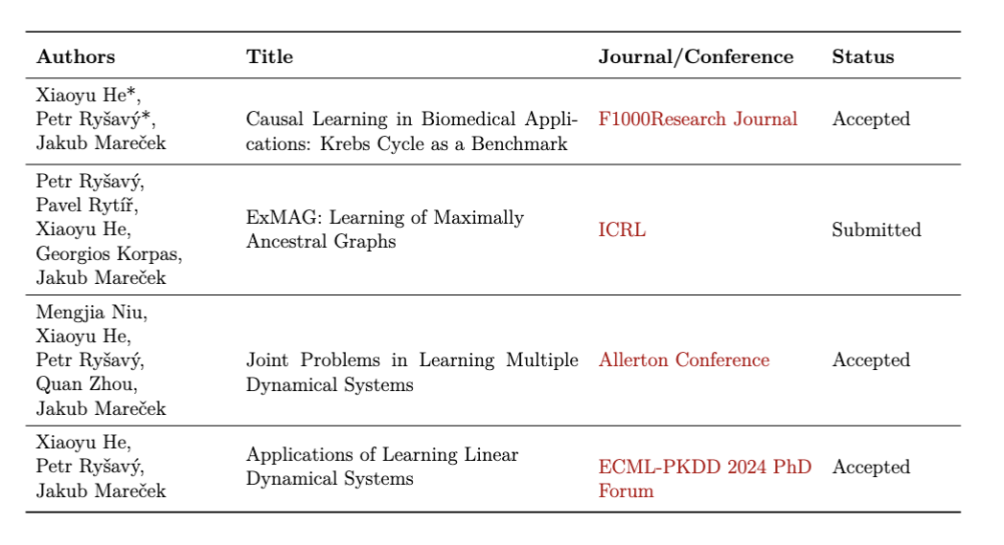
List of Publications
The asterisk (*) indicates equal contribution.

Slide 3
CONTENTS
01
Research Motivation
02
Benchmarking Dataset
03
ExMAG: Causal Graph Learning
04
Jointly Learning Complex Dynamical Systems
05
Contributions and Impact
06
Future Directions

Slide 4
01
Research Motivation

Slide 5
Why Causal Discovery Matters
Understanding complex systems in biology and medicine requires more than correlation. We need to uncover the WHY behind dynamic processes.
The Challenge
The traditional methods fail to capture feedback loops and hidden confounders, limiting their ability to model dynamic processes like the Krebs cycle.

Slide 6
The Limits of Static Causal Models
Static Models
Real-World Systems
Assume static and acyclic relationships
Require full observability
Cannot model feedback loops
Fail with hidden confounders
Rich in cyclic interactions
Have unmeasured variables
Exhibit dynamic feedback
Are full of confounders
These limitations lead to biased causal inferences and poor generalizations in dynamic environments.

Slide 7
02
Benchmarking Causal Methods

Slide 8
Acetyl CoA
Acetyl CoA
A New Standard:
The Krebs Cycle
Acetyl CoA
Citric acid
Citric acid
Citric acid
Oxaloacetate
Cis-aconitate
H₂O
Oxaloacetate
Cis-aconitate
H₂O
We propose the Krebs cycle as a realistic benchmark for evaluating causal discovery in dynamic systems. It moves beyond synthetic data to a complex, real-world process.
NADH
NADH
Oxaloacetate
Cis-aconitate
H₂O
NAD⁺
NADH
差不
NAD⁺
NAD⁺
Malate
Isocitric acid
Malate
Isocitric acid
Malate
Isocitric acid
Cyclic Interactions: Real-world biological process with inherent cyclic interactions.
α-Ketoglutaric acid
NAD⁺
H₂O
Fumarate
NADH
NAD⁺
H₂O
α-Ketoglutaric acid
NADH
NAD⁺
Fumarate
α-Ketoglutaric acid
NADH
H₂O
Fumarate
Latent Factors: Includes latent biochemical variables.
Succinate
Succinyl CoA
NAD⁺
NAD⁺
Succinate
Succinyl CoA
NADH
NAD⁺
Time-Series Data: Provides a challenging temporal testbed.
FAD
Succinate
Succinyl CoA
NADH
NADH
FAD
H₂O
H₂O
H₂O
FAD
GTP
GDP
GDP
GDP
GTP
GTP

Slide 9
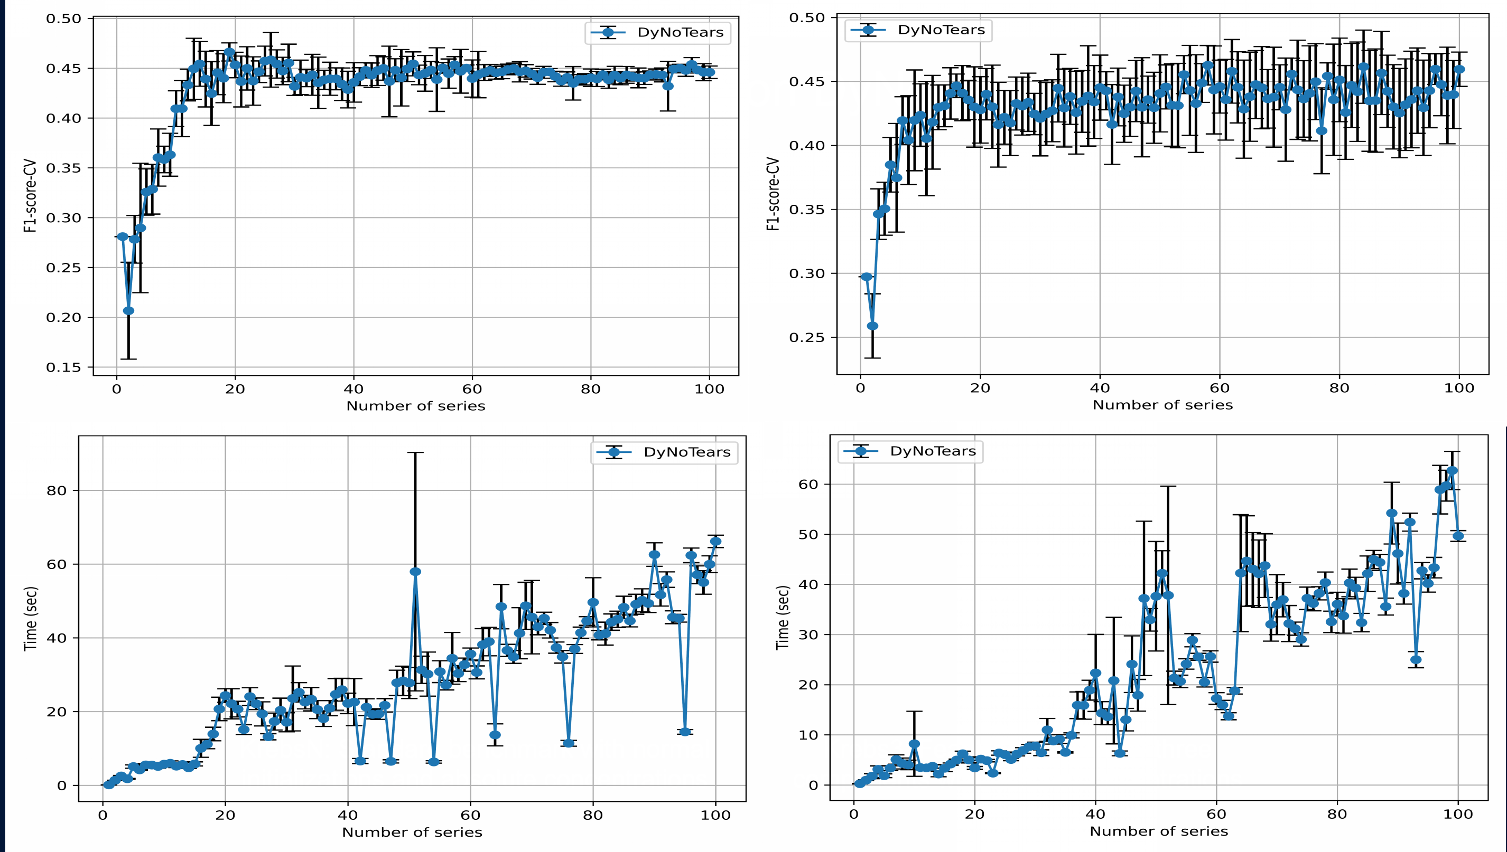
Performance on DyNoTears
Krebs3: Feature excitation of three components
KrebsN: normal initializations
Roxana Pamfil, Nisara Sriwattanaworachai, Shaan Desai, Philip Pilgerstorfer, Konstantinos Georgatzis, Paul Beaumont, and Bryon Aragam. DyNoTears: Structure learning from time-series data. In International Conference on Artificial Intelligence and Statistics, pages 1595–1605. Pmlr, 2020.
Notes:
KrebsN: normal distribution.
Krebs3: excitation of three components

Slide 10
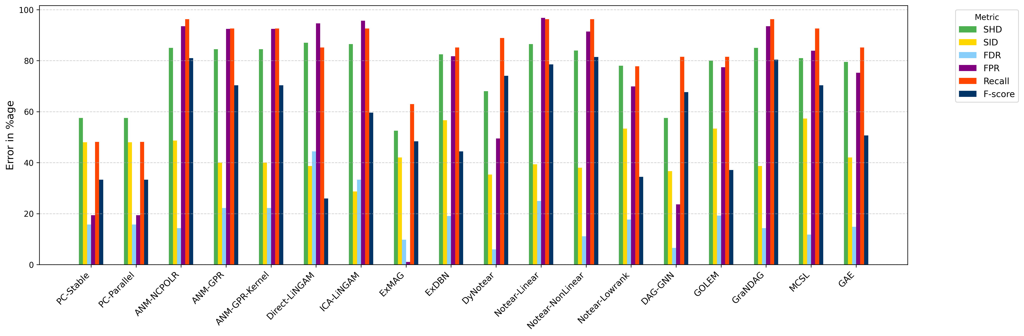
Comparison Between Causal Inference Algorithms
by percentage of error in performance metrics for Krebs3 dataset.
Keli Zhang, Shengyu Zhu, Marcus Kalander, Ignavier Ng, Junjian Ye, Zhitang Chen, and Lujia Pan. gcastle: A python toolbox for causal discovery. arXiv preprint arXiv:2111.15155, 2021.
Notes:
Comparison between varying causal inference algorithms by percentage of error in performance metrics for Krebs3 dataset.
Structural Hamming Distance measures the number of edge edits needed to match the true graph.
Structural Intervention Distance counts pairs where interventional distributions differ.
F1-Score balances precision and recall for edge prediction accuracy.

Slide 11
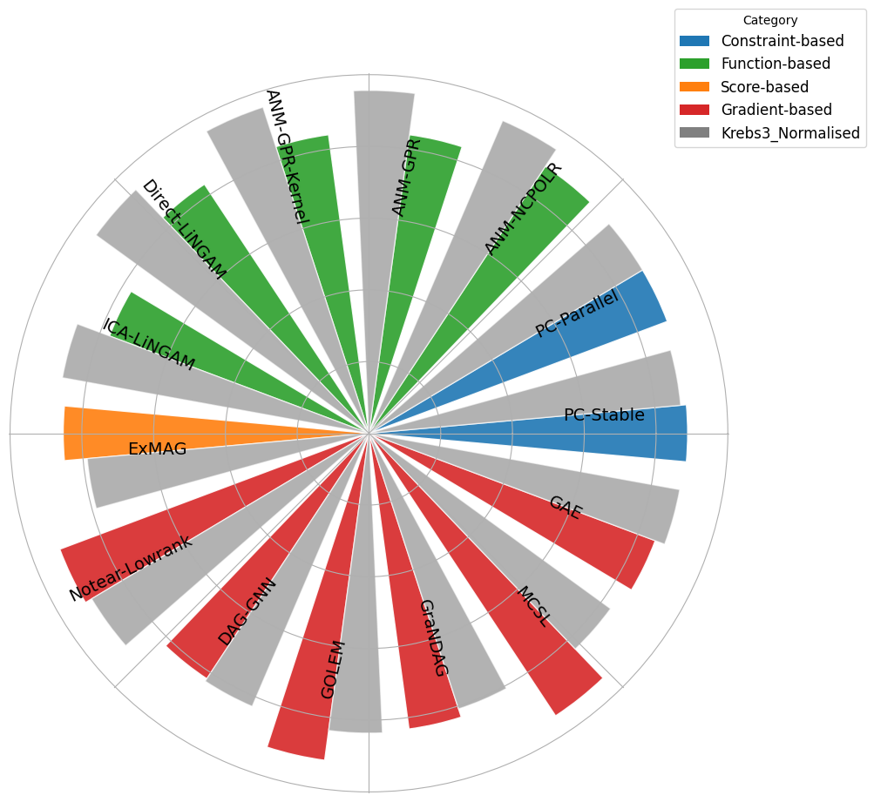
Radial Bar Plot: Comparing Across Algorithm Categories
SID scores
Krebs3(color) vs. KrebsN(gray)
The performance of each method is represented with colour-coded sections in a radial bar plot.
The grey overlay indicates the performance on the normalised dataset.
Keli Zhang, Shengyu Zhu, Marcus Kalander, Ignavier Ng, Junjian Ye, Zhitang Chen, and Lujia Pan. gcastle: A python toolbox for causal discovery. arXiv preprint arXiv:2111.15155, 2021.
Notes:
SID scores of various algorithms grouped by category for Krebs3
and KrebsN datasets. The performance of each method is represented with colour-
coded sections in a radial bar plot. The grey overlay indicates the performance on the
normalised dataset.

Slide 12
03
ExMAG: Causal Graph Learning

Slide 13
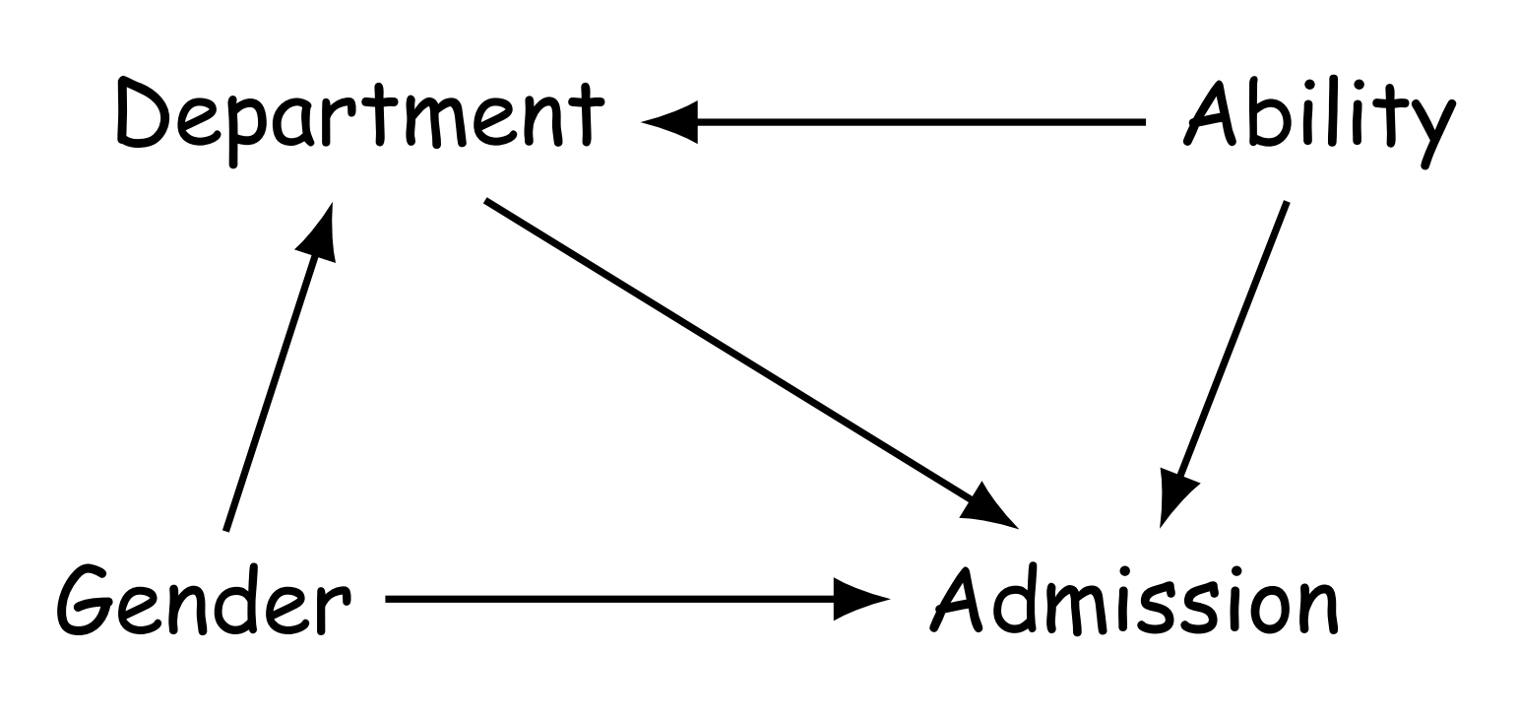
ExMAG: Seeing the Unseen
ExMAG learns Maximal Ancestral Graphs (MAGs), which extend DAGs to model hidden variables and bidirected edges for confounding effects.
Accurate discovery with unobserved confounders.
Improves robustness in real-world applications.
An Example of Confounding: Berkeley graduate admissions
Provides a more expressive causal representation.
Richard McElreath. Statistical rethinking: A Bayesian course with examples in R and Stan. Chapman and Hall/CRC, 2018.
Notes:
To illustrate the challenge of confounding, lets consider a simple hypothetical example also known as Simpson’s paradox-Berkeley graduate admissions. Suppose that department A receives 150 applications, 100 from men and 50 from women. Department B also receives 150 applications, but here 50 are from men and 100 are from women. Suppose that department A has an acceptance rate (for men and women) of 80%, and department B has an acceptance rate (for men and women) of 20%. Then department A admits 80 men and 40 women, whereas department B admits 10 men and 20 women. Overall, 90 men and 60 women are admitted, giving an acceptance rate of 60% for men and 40% for women. This suggests that success at admission to Berkeley is positively correlated with being male. it suggests that there may be sex discrimination in the selection procedure.
However, as observed from example, this is because women tend to apply to departments that have lower admission rates. In this example, the choice of the graduate school or ability is the confounder, impacting the probability of admission.

Slide 14
MIQP Formulation
The cost function for the Mixed Integer Quadratic Program(MIQP) of ExMAG is the following L_{q} norm:
where:
Y_{i,m} represents the value of the m-th variable for the i-th data point;
w_{j,m} represents the weight of the edge from variable m to variable j;
e_{j,m} is the binary decision variable indicating the presence of a directed edge from j to m;
b_{j,m} is the binary decision variable indicating a bidirected edge between j and m;
λ ∈ ℝ⁺ is a regularization parameter controlling the model fit and the edge penalty trade-off.
The exponent q ∈ℕ can take values q = 1 or q = 2.

Slide 15
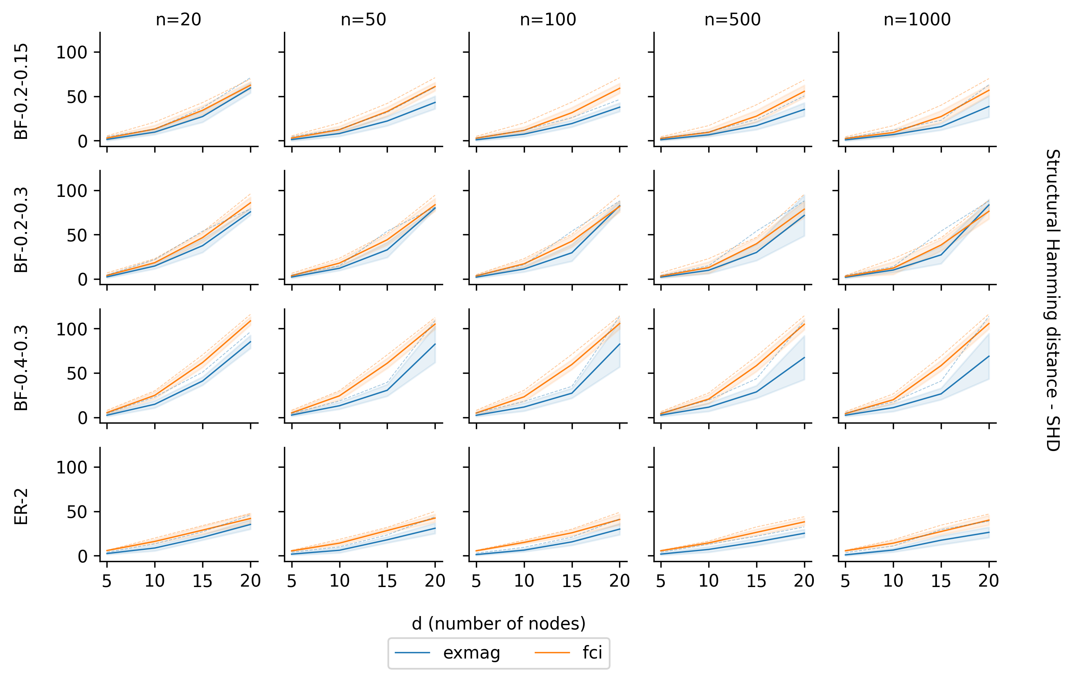
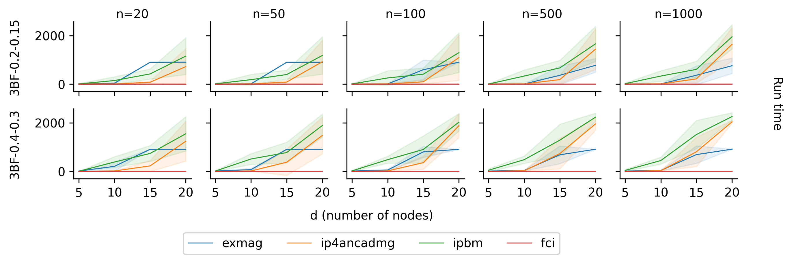
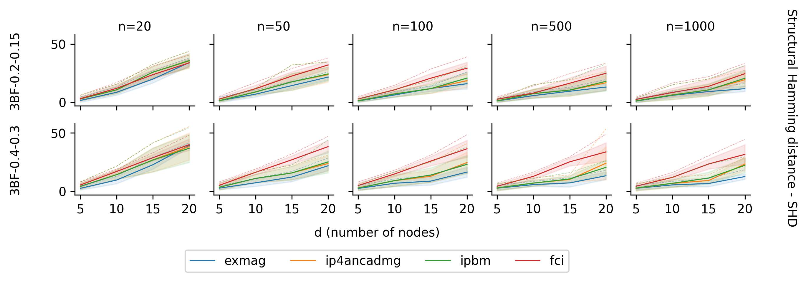
ExMAG Performance
Comparisons Between ExMAG and FCI algorithm
Comparisons Between ExMAG, IP4AncADMG, PBMs and FCI
SHD values for different settings of graph
Runtime and SHD values
[IP4AncADMG] Rui Chen, Sanjeeb Dash, and Tian Gao. Integer programming for causal structure learning in the presence of latent variables. In International Conference on Machine Learning, pages 1550–1560. PMLR, 2021.
[PBMs] Sanjeeb Dash, Joao Goncalves, and Tian Gao. Integer programming based methods and heuristics for causal graph learning. In The 28th International Conference on Artificial Intelligence and Statistics, 2025.
[FCI] Peter Spirtes, Christopher Meek, and Thomas Richardson. Causal inference in the presence of latent variables and selection bias. In Proceedings of the Eleventh Conference on Uncertainty in Artificial Intelligence, UAI’95, pages 499–506, San Francisco, CA, USA, August 1995. Morgan Kaufmann Publishers Inc. ISBN 978-1-55860-385-1.

Slide 16
04
Jointly Learning Complex Dynamical Systems

Slide 17
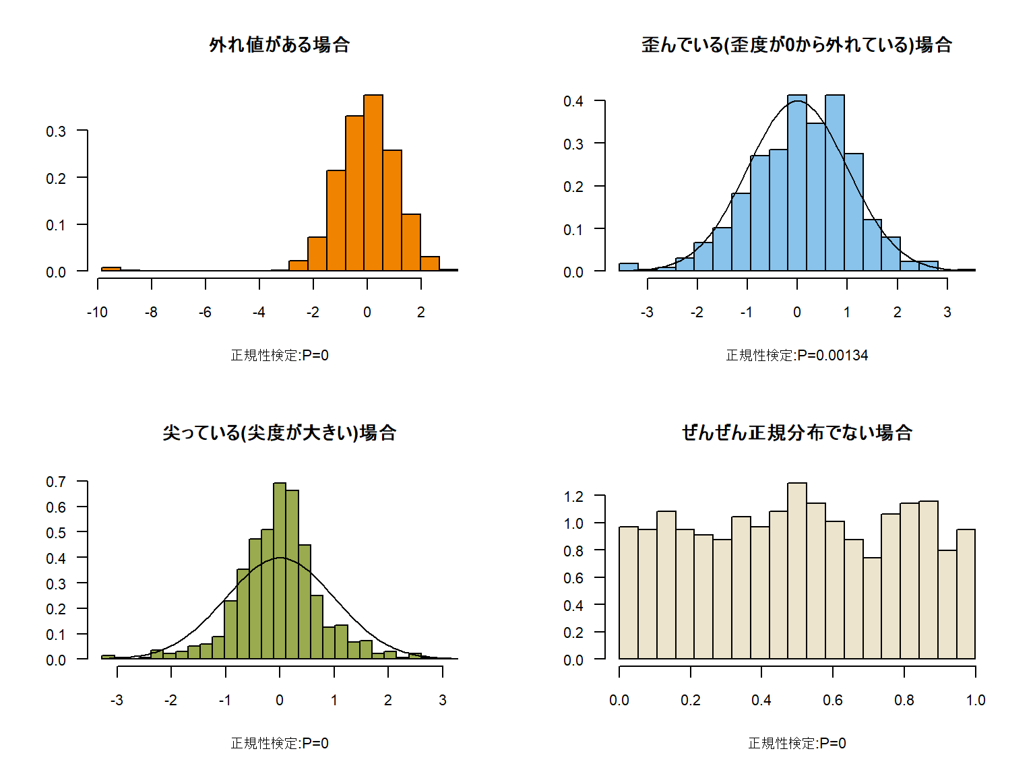



Jointly Learning Complex Dynamical Systems
We address the joint problem of clustering time-series trajectories and learning a Linear Dynamical System (LDS) for each cluster.
This enables the discovery of shared latent structures and cross-system dependencies, improving statistical efficiency.
$$\overset{→}{X_{t}^{1}}$$
L1
...
$$\overset{→}{X_{t}^{2}}$$
L2
$$\overset{→}{X_{t}^{M}}$$
...
S
T
Hidden State
Observation State

Slide 18




LDS and The NCPOP Framework
The Non-Commutative Polynomial Optimization (NCPOP) framework formulates the joint clustering problem as Linear Dynamical System (LDS).
Let m be the hidden state dimension and n be the observational dimension. A single realisation of the LDS of length T, denoted Y={ y_{1,}y₂ , ... , y_{T} } ∈ℝ^{M×S×T} is defined by initial conditions X₀ and system matrices G and F as
where X_{t} ∈ ℝ^{m×s} is the vector autoregressive processes with hidden components and {ω_{t},υ_{t}}_{t∈{1,2,...,T}} are normally distributed process and observation noises with zero mean and covariance of Σ_{H} and Σ_{O} respectively. The transpose of F is denoted as F’. Vector Y_{t} ∈ ℝ^{n×s} is the observed output of the system.
Operator-Valued
Variables are operators in an unknown dimension.
→
Global Optima
Finds the best solution without local minima traps.
Convergence Guarantees
Theoretical assurance of finding the optimal solution.

Slide 19
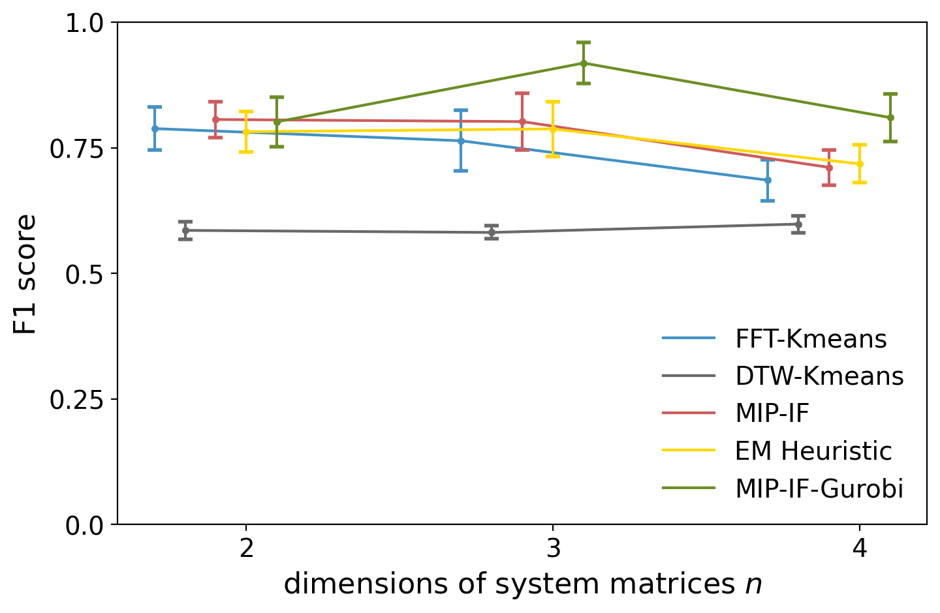
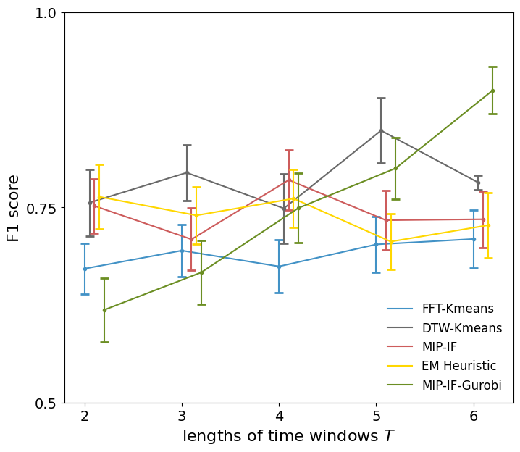
Real-World Performance: ECG Data
Superior Clustering Accuracy
Robustness to Window Size
The EM heuristic achieves high F1-scores on sythetic data, outperforming baselines.
Performance remains stable even with shorter time windows, unlike other methods.

Slide 20
05
Contributions and Impact

Slide 21
Key Contributions
1. A Motivating Benchmark
A realistic Krebs cycle benchmark to evaluate dynamic causal discovery.
2. The ExMAG Algorithm
3. Joint LDS Framework
A novel method for learning causal graphs with latent confounders.
A method to cluster and learn multiple interacting dynamical systems.
It contributes to three real-world challenges in causal inference: temporality, confounding and joint clustering.
Notes:
4. Methodology – Overview [1:00]
My work is organized into a triangle:
Pillar I: Benchmarking with Krebs cycle data → exposes gaps in current methods.
Pillar II: Causal discovery with hidden variables → the ExMAG algorithm.
Pillar III: Joint clustering & system identification → NCPOP-EM framework.
(用手指示意三柱模型，做小手势)
These pillars are not isolated—they feed into each other. Benchmarks guide algorithms, and algorithms provide realistic data for the benchmarks.

Slide 22
Theoretical Advances
We provide formal guarantees and complexity analyses for the proposed methods, bridging theory and practice.
Convergence Guarantees: Proving NCPOP-based learning converges to global optima.
Polynomial Reductions: Showing LDS clustering is reducible to Gaussian mixture clustering.
Hardness Results: Formalising the computational complexity of joint causal and dynamical modeling.

Slide 23
From Theory to Real-World Impact
Biomedicine
Neuroscience
Bioinformatics
Model disease progression and understand the effects of dietary interventions.
Identify brain diseases (e.g. epilepsy) patients EEG from normal patients.
Incorporating latent variable can detect confounders in genetic association studies
Our methods support critical tasks where understanding causal dynamics is essential.

Slide 24
06
Future Directions

Slide 25
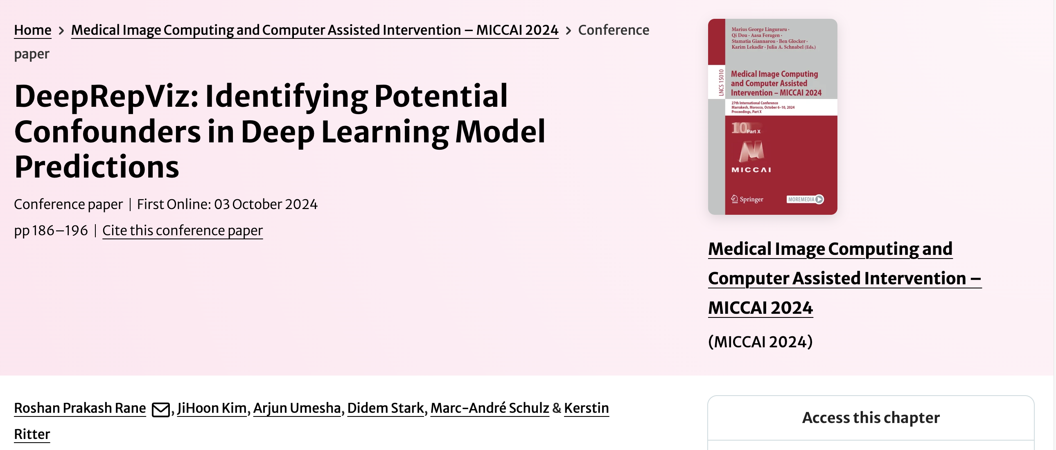
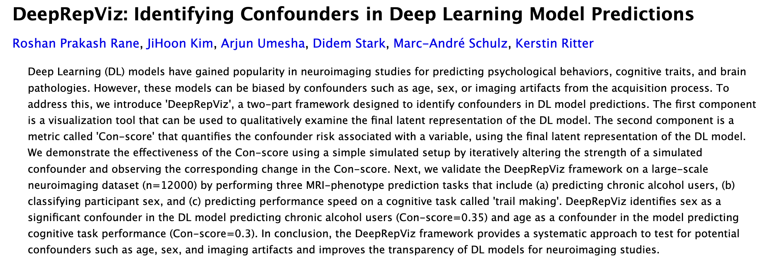
Future Work: Constrained Training of DNNs
Future work focuses on building up a toolkit.
Faster algorithms: for example, using clique-width pruning for ExMAG.
Identifiability: especially for tree-structured causal models.
Integration with Deep Learning: apply constrained training of DNNs.

Slide 26
Open Questions & Future Frontiers
Non-Stationarity
Feedback Control
Partial Observability
How can we learn causal models that adapt to changing distributions over time?
How do we model systems where our interventions actively shape the future?
How can we reason about causality when we only see a fraction of the system?
Addressing these will extend causal inference to adaptive and interactive systems.

Slide 27
THANK YOU!
Artificial Intelligence Center Faculty of Electrical Engineering Czech Technical University in Prague

